Slide 1

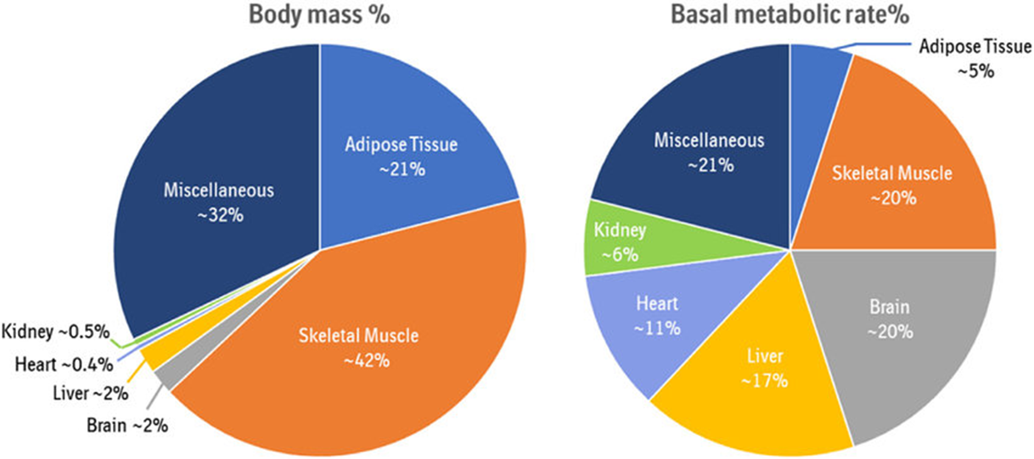
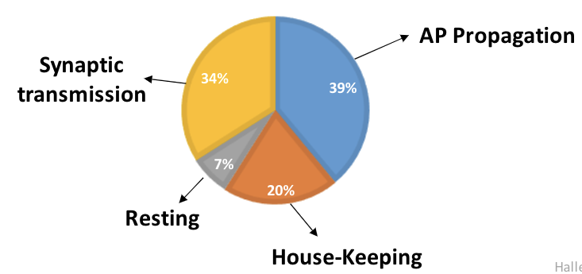
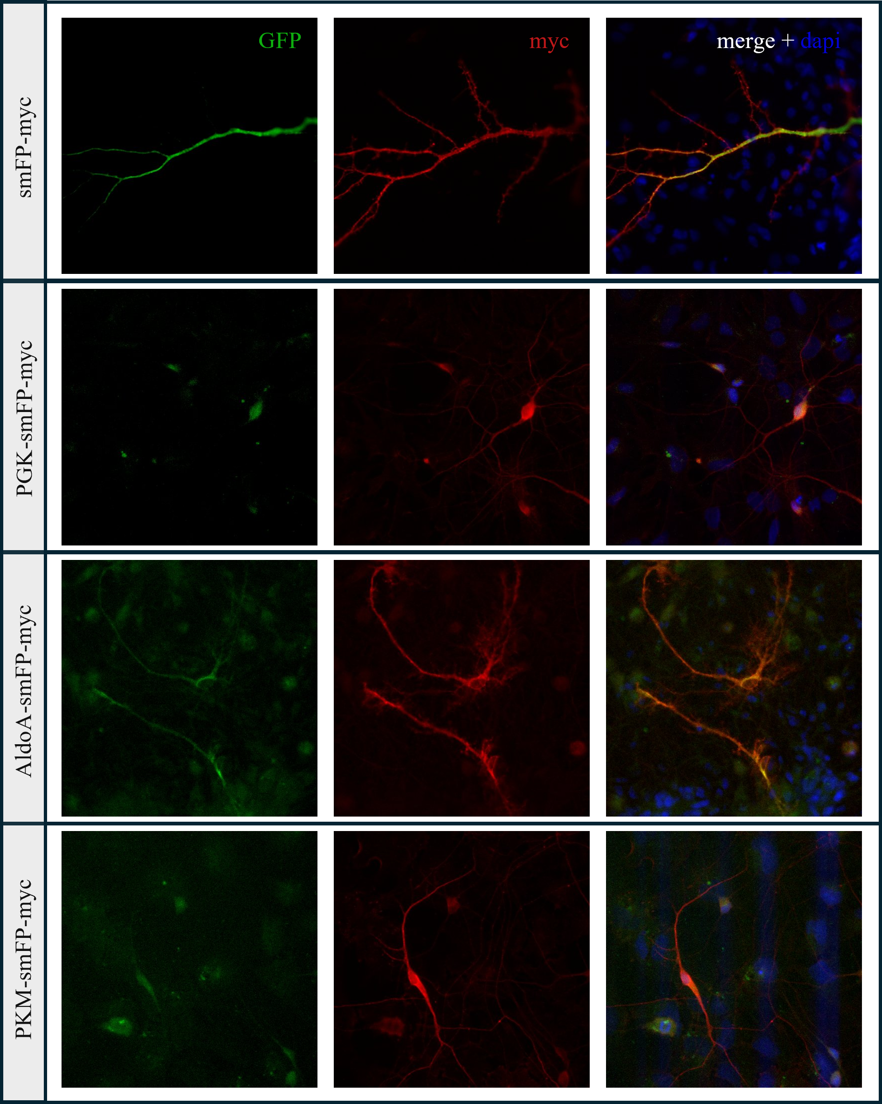
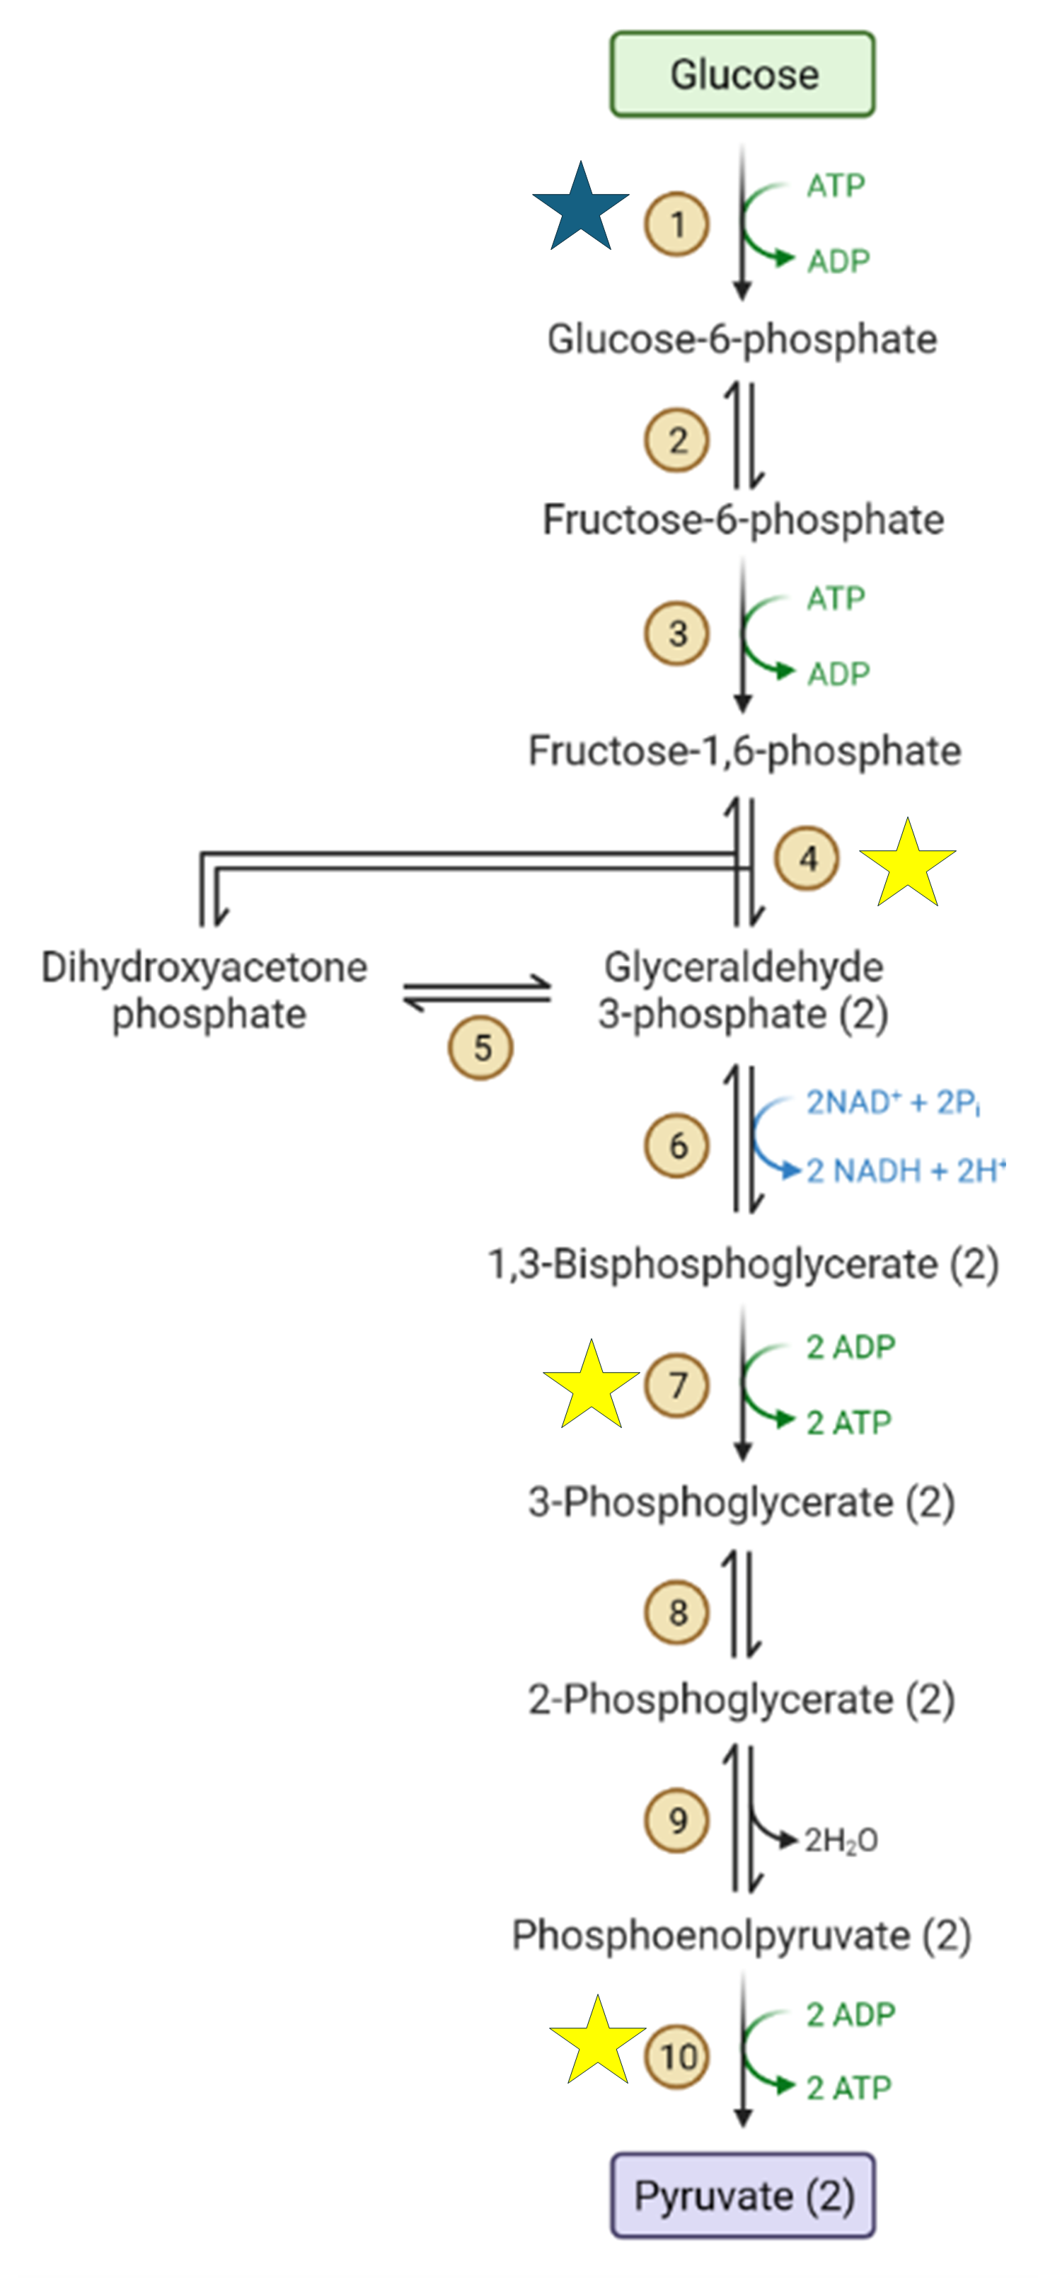
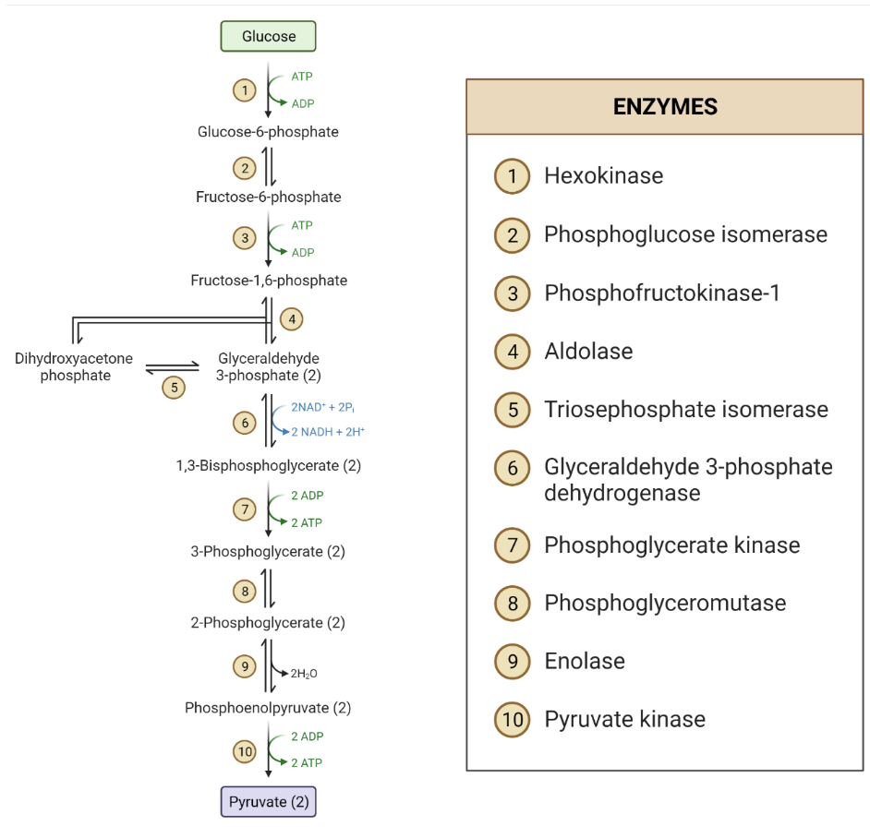
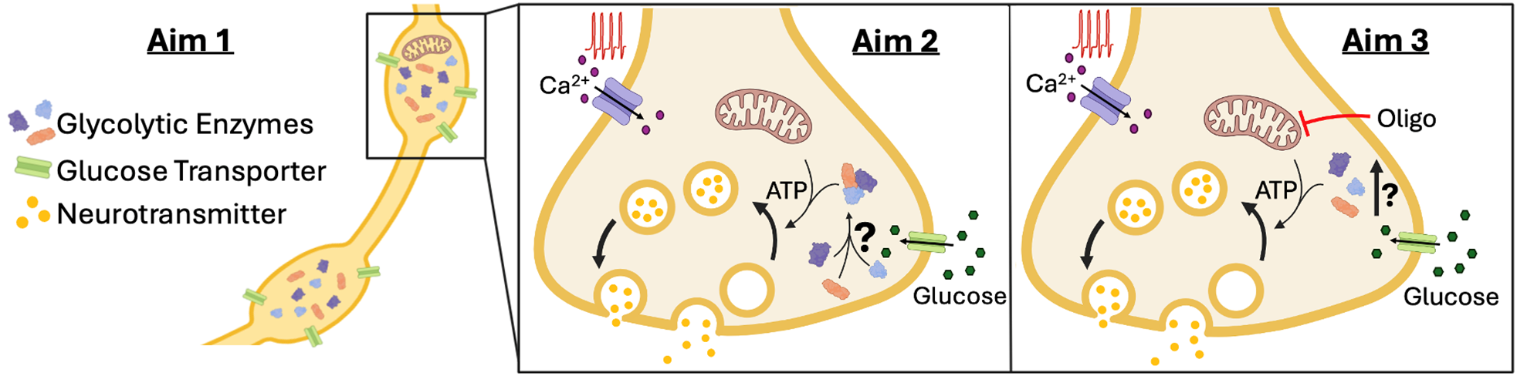
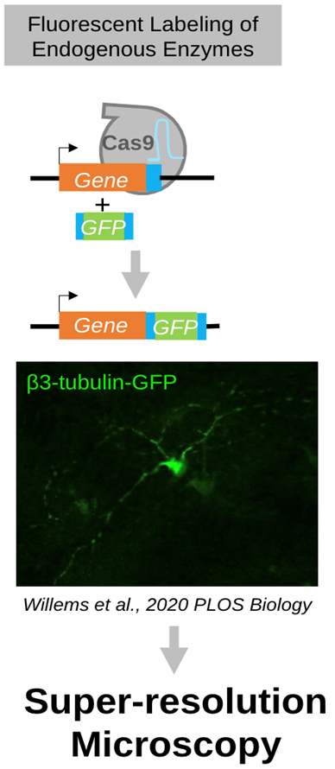
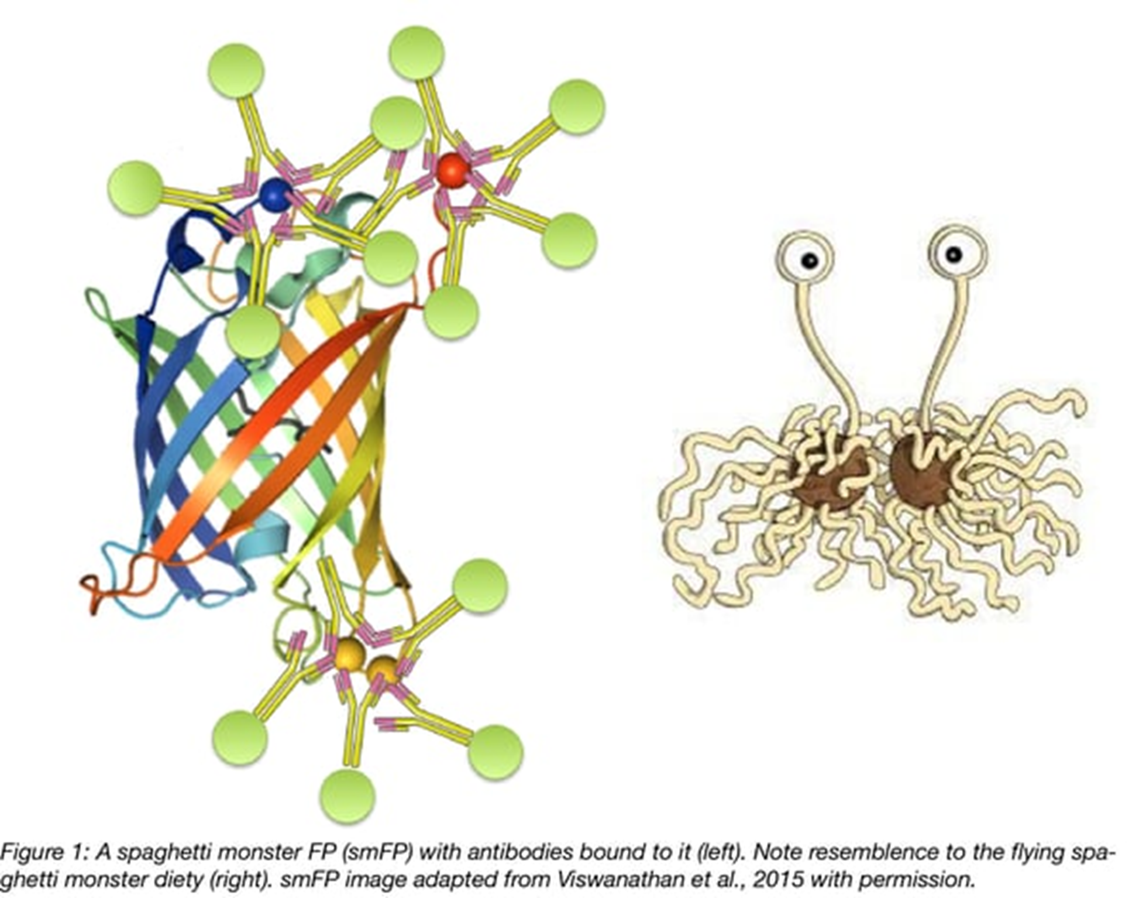
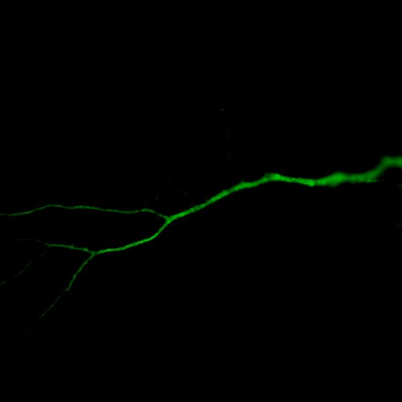
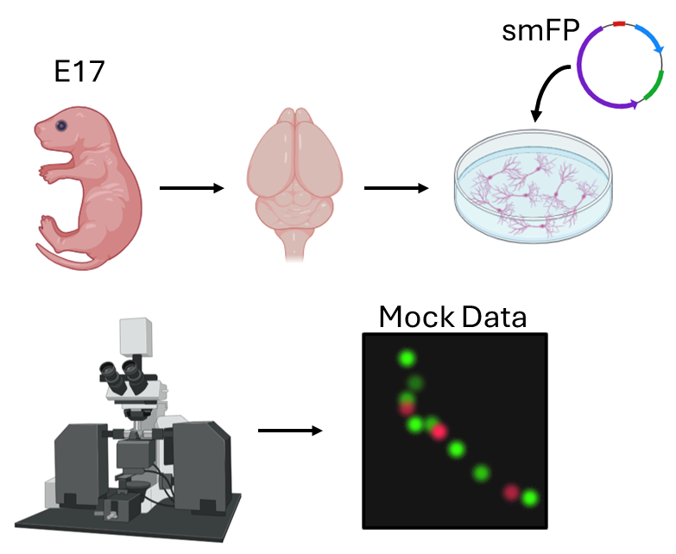
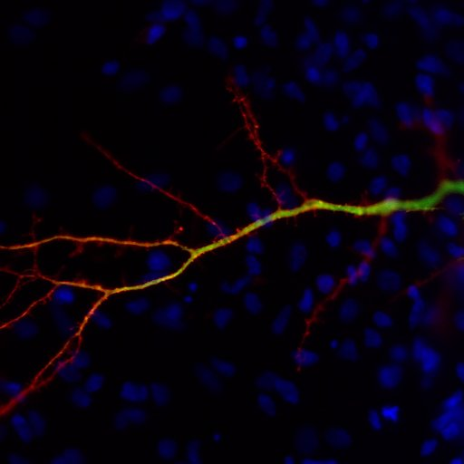
Exploring Spatial Dynamics of Glycolytic Enzymes at the Mammalian Nerve Terminal
Davin Harvey, Kelly Wichmann, Alexandra Ware, Ghazaleh Ashrafi
WashU Medicine Department of Cell Biology and Physiology
Introduction
Preliminary Results
Neuronal transmission within the brain is incredibly metabolically demanding, yet access to glucose (the brains main energy source) fluctuates significantly. Cognitive function is dependent on efficient metabolism and energy production. As neuronal transmission represents the brain’s main metabolic demand, neuron firing creates a substantial, transient energy requirement. The two main energy production pathways in the neuron are oxidative phosphorylation and glycolysis. While glycolysis remains understudied, it may play a critical role in rapid energy production due to its capacity to generate ATP more quickly than oxidative phosphorylation. Previous work has found localization of glycolytic enzymes into metabolons during periods of neuronal stress in C. elegans, suggesting dynamic activity. Our lab aims to elucidate the spatial dynamics of glycolytic enzymes at the mammalian neuronal synapse. The investigation seeks to clarify the role of glycolytic ATP production in supporting synaptic transmission. Energy dysregulation is increasingly recognized as an early sign of neurodegeneration, and studying this dysregulation in mammals can provide a deeper insight relevant to human health. We hypothesize that glycolysis is essential for the energetic support of synaptic activity, particularly at terminals lacking mitochondria. Additionally, we propose that glycolytic enzymes form transient clusters to enhance energy production efficiency.
Figure 2. Pie chart demonstrating the significance of synaptic transmission. Although the brain makes up around 2% of the body’s mass, the brain consumes approximately 20% of the basal metabolic rate. 34% of the brain’s expenditure is devoted to synaptic transmission. Synaptic transmission consumes a significant portion of the body’s energy.
Research Methods
ORANGE (Open Resource for the Application of Neuronal Genome Editing) method tags key glycolytic enzymes with fluorescent protein smFP
Transfect prenatal rat pup cortical neurons with edited plasmids
CRISPR/CAS9 edits genome to add fluorescent tags to glycolytic genes in neurons
To increase fluorescence, stain transfected neurons with anti-myc, an antibody that binds to the smFP protein
Tagged glycolytic enzyme levels are quantified through fluorescence intensity at synapses with high-resolution microscopy
Figure 1. Aims 1 and 2 are highlighted. Aim 1: Examine the heterogeneity of glycolytic machinery across nerve terminals of a single neuron. In Aim 1 (left), we hypothesize there will be more glycolytic enzymes in synapse lacking mitochondria. Glycolytic enzymes and glucose transporters are labeled in this diagram. We expect to see more of this machinery at the bottom synapse without mitochondria. Aim 2: Establish spatiotemporal dynamics of glycolytic enzymes during neuronal activity. In Aim 2 (right), we hypothesize that glycolytic enzymes will form transient clusters to enhance energy production efficiency during stimulation. The glycolytic enzymes can be seen forming a glycolytic metabolon in the diagram.
Figure 7. Sample images of successfully transfected prenatal rat pup neurons with tagged glycolytic enzymes. GFP fluorescence represents smFP expression in the absence of myc antibodies. Myc antibodies are introduced and attach to smFP to enhance fluorescence, which is imaged. Upon introduction of myc antibodies, which bind to smFP, fluorescence is enhanced and subsequently imaged. Merged images confirm colocalization, with myc fluorescence appearing more intense than GFP. DAPI staining indicates nuclei in the merged images. The top row displays smFP-myc overexpression as a control, while the subsequent rows show endogenous tagging of glycolytic enzymes PGK (second row), AldoA (third row), and PKM (bottom row) under resting conditions.
Conclusions & Future Direction
smFP
Stain mitochondria with MitoTraker and presynaptic marker VGLUT1 in cortical neurons to visualize using high-resolution STED microscopy
Transfect cortical neurons with key glycolytic enzyme hexokinase to understand more clearly localization of glycolytic enzymes
Prove successful transfection by transfecting cortical neurons and adding primers to isolate genomic DNA for sequencing
Electrically stimulate nerves with tagged enzymes and observe localization behavior of glycolytic enzymes
smFP
Figure 4. Spaghetti Monster Fluorescent Protein (smFP) diagram with antibodies bound to it. Resembles the flying spaghetti monster deity.
Acknowledgments and References
Figure 3. Diagram depicting the steps of fluorescent labeling. CRISPR/Cas9 machinery is implemented into plasmids. Once transfected into cortical neurons, the CRISPR/Cas9 machinery is expressed and activated, targeting specific glycolytic enzyme genes. Using the ORANGE method, the machinery results in the attachment of the smFP tag to the desired glycolytic enzymes. The fluorescence from these tagged glycolytic enzymes is then visualized and analyzed using high-resolution microscopy.
Figure 6. Glycolytic pathway. Enzymes that are tagged with smFP and myc are starred with yellow. Hexokinase, which is to be soon tagged, is starred with blue.
I would personally like to thank my mentor Kelly Wichmann, Dr. Ghazaleh Ashrafi, and the rest of the Ashrafi lab for helping me explore the field of research.
References:
Figure 2, Hallermann et al., 2012
Figure 3, Willems et al, 2020 PLOS Biology
Figure 4, Viswanathan et al. 2015
Figure 5. Diagram depicting the transfection process in detail. Rat pups are extracted from pregnant mothers at Embryonic Day 17 (E17). The cerebral cortex is extracted for the pups to harvest cortical neurons which are dissociated gently with papain into a single-cell suspension and plated. The neurons are then imaged, and fluorescence is analyzed.

